Slide 1
Veeam Backup & Replication v7
Taking Modern Data Protection to the next level
Notes:
20130904

Slide 2
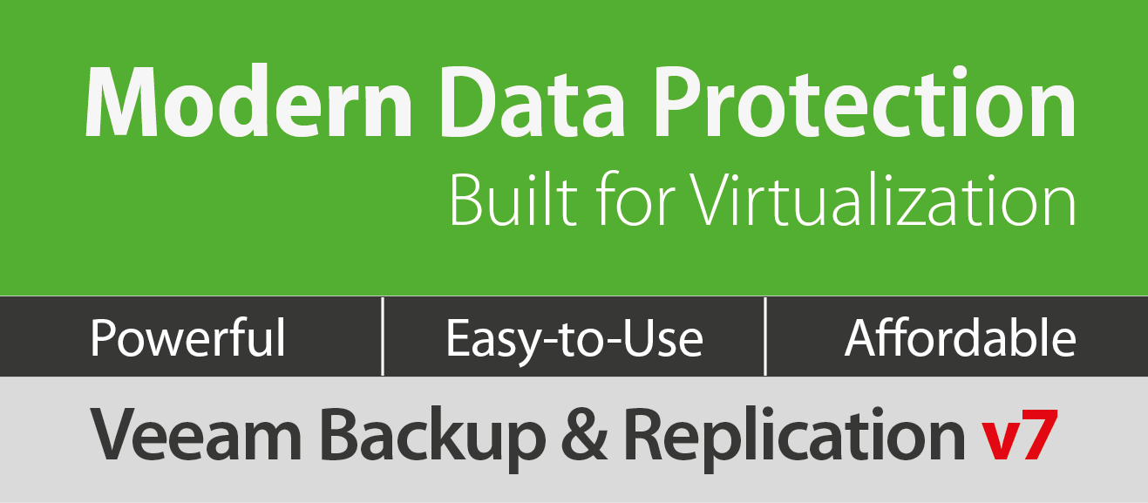
Taking Modern Data Protection to the next level
NEW!

Slide 3
What’s inside v7?
2 disruptive innovations
Built-in WAN Acceleration
Backup from
Storage Snapshots
7 market-
leading features
Enhanced backup
and recovery
for vCloud Director
Native tape support
Veeam Explorer for Microsoft SharePoint
Virtual Lab for Hyper-V
Self-Service Recovery
vSphere Web Client
plug-in
Virtual Lab for replicas
50+ other new
features and
enhancements
Backup Copy jobs
RESTful API
Full Instant File-Level Recovery (IFLR)
for Hyper-V
…and more!

Slide 4
How does v7 benefit you?
Remove the hurdles
to offsite backup
  Built-in WAN Acceleration
  Backup Copy jobs
  Native tape support
  Backup from Storage Snapshots
  Virtual Lab for Hyper-V
  Virtual Lab for replicas
  Enhanced support for vCloud Director
  vSphere Web Client plug-in
Get more out of your
virtual infrastructure
Restore exactly
what you need
in minutes, not hours
  1-Click Restore for VMs
  Self-service recovery for VMs and guest files
  Veeam Explorer for Microsoft SharePoint
  Veeam Explorer for Microsoft Exchange 2013

Slide 5
History of innovation
v1
v3
v5
6.1
Cloud Edition
2-in-1: backup
and replication
Instant File-Level Recovery
Built-in deduplication
Synthetic full backups
Replication multiple restore points
Instant File-Level
Recovery for Linux
ESXi support
without VCB
vPower
Instant VM Recovery
SureBackup
U-AIR
On-Demand
Sandbox
Instant indexing
VeeamZIP
vPower for Hyper-V
Veeam Backup
Free Edition
Archive backups
to the cloud
Q1 08
Q3 08
Q1 09
Q4 09
Q4 10
Q4 11
Q2 12
Q4 12
Q1 13
Q3 13
v2
v4
6.0
6.5
v7
ESXi support
with VCB
Fastest VCB
performance
Advanced VSS
support
Centralized
management
Support for
vStorage APIs
Support for CBT
Support for thin-
provisioned disks
Near-CDP
Replication
to ESXi
Enterprise scalability
Advanced replication
Hyper-V support
1-Click File Restore
Veeam Explorer for Microsoft Exchange
Veeam Explorer for Storage Snapshots
New hypervisor
support:
vSphere 5.1
and Windows Server 2012 Hyper-V
Built-In WAN acceleration
High performance Backup from Storage Snapshots
Veeam Explorer for Microsoft SharePoint
Virtual Lab for Hyper-V
Virtual Lab for replicas

Slide 6
Remove the hurdles to offsite backup

Slide 7
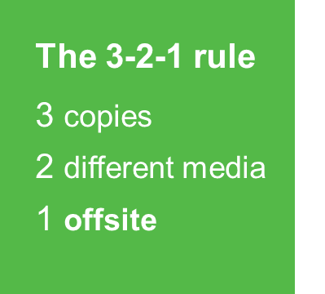
Challenge:
Backup availability
It can be difficult to follow the 3-2-1 rule without:
Creating extra backups
Maintaining complicated copy scripts
Result - additional time, storage, compute resources and cost

Slide 8
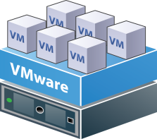
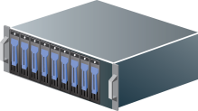
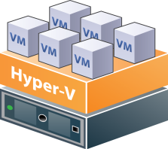
Solution:
Backup Copy jobs
Highly efficient
Automatically copies VMs to local or offsite storage location
Validation and remediation ensure copies are available and reliable
Minimizes backup overhead and expense
Enables proper backup and retention policies without extra backups, copy scripts, or capabilities like storage-based file replication
Backup
Backup Copy
NEW!
Production
storage
Primary
backup storage
Secondary backup storage

Slide 9
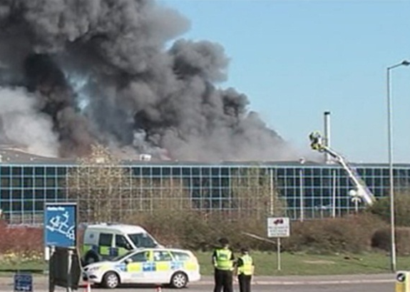
Challenge:
Getting backups offsite
Getting backups offsite is time-consuming and costly:
Bandwidth is limited:
cost and availability
WAN accelerators are not
the answer:
expensive, not workload optimized, may create interoperability issues

Slide 10

Solution:
Built-in WAN Acceleration
Up to 50x faster than standard file copy with:
Caching
Deduplication
Technology built by Veeam, optimized for Veeam backups
  Easy – no agents, no additional configuration, no network setup
Backup
Backup Copy
Production
storage
Primary
backup storage
Offsite storage
WAN acceleration

Slide 11
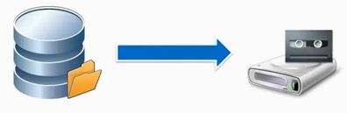
Challenge:
Getting backups onto tape
Organizations are often required to store backups on tape
Company policy
Regulatory requirements
Prior investment in tape resources

Slide 12
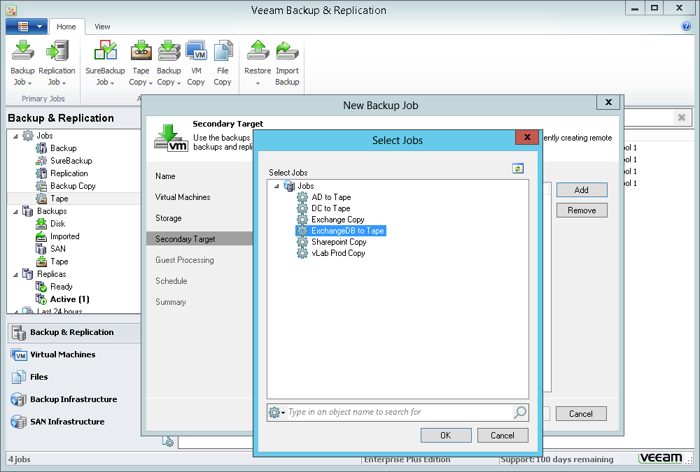
Solution:
Native tape support
Copies and tracks files, backups and restore points on tape
Supports virtual tape libraries (VTLs), tape libraries and standalone drives
Fully integrated into Veeam Backup & Replication
Simplifies restore from backups stored on tape

Slide 13
Important details
Supported tape hardware: LTO3 or later tape libraries (including virtual tape libraries) and standalone drives
Tape device must be directly attached to the Veeam backup server via SAS, FC, or iSCSI
Device-specific, vendor-supplied OEM driver for Windows must be installed

Slide 14
Get more out of your virtual infrastructure

Slide 15
Challenge:
Improving RPOs
Organizations are under pressure
Stricter business continuity requirements
Lower tolerance for data loss
Efforts are impacted by:
Shrinking backup windows
Need to leverage investment in storage
RPO :
Recovery Point Objective

Slide 16




Solution:
Backup from Storage Snapshots
Near-continuous data protection
Create backups as often as every 5 minutes
No impact on production environment or running VMs
Leverages Changed Block Tracking
Enables instant VMware
snapshot commit
Up to 20x faster than
the competition
VM
VM
VM snapshot
VM
1
Veeam Backup Server
LUN
1
2
SAN
snapshot
VM
VM
VM
VM
VM
VM
VM
VM
VM
VM
VM
VM
Production Storage
Backup Repository
VMware only

Slide 17
Storage snapshot roadmap
Introduced recovery from SAN snapshots in v6.5
Extending SAN support in v7 with backup from storage snapshots
New plug-in architecture in v7 makes it easy to add support for other storage vendors
Veeam Explorer for Storage Snapshots
Additional storage options
v7
2012
2013
…
v6.5
Backup from
Storage Snapshots
Plug-in architecture

Slide 18
Important details
Supported storage
  HP StoreVirtual VSA
  HP StoreVirtual (Lefthand, P4000)
  HP StoreServ (3PAR)

Slide 19

Challenge:
Reduce risk and leverage Hyper-V backups
  Administrators need to know backups are recoverable
  Leverage backups for:
    Granular recovery with little to no impact on production users
    Isolated environments are needed for testing, training and troubleshooting

Slide 20
Solution:
Virtual Lab for Hyper-V
When you need to… | Virtual Lab enables…
Automatically verify the recoverability of every VM backup | SureBackup
Recover application items for any virtualized application - without agents or special backups | U-AIR (Universal Application-Item Recovery)
Set up isolated environments for testing software and patches, troubleshooting issues, or training | On-Demand Sandbox

Slide 21
Important details
Requires Microsoft Windows Server 2012

Slide 22
Challenge:
Reduce risk and leverage replication resources
  Replication from Veeam offer many benefits
  Very quick RTOs
  Easy off-site recovery options
  Assisted failover and failback
  Organizations also want to:
  Know replicas are reliable
  Put standby DR resources to work

Slide 23








Solution:
Virtual Lab for replicas
¸
¸
¸
SureReplica
·
·
·
¹
VM
OS
Hypervisor
App
Report
SureReplica: automatically verify every restore point in every replica
U-AIR: fastest recovery of items from any virtualized application
On-Demand Sandbox: utilize disaster recovery environments for testing, training and troubleshooting
Production storage
VMware only

Slide 24
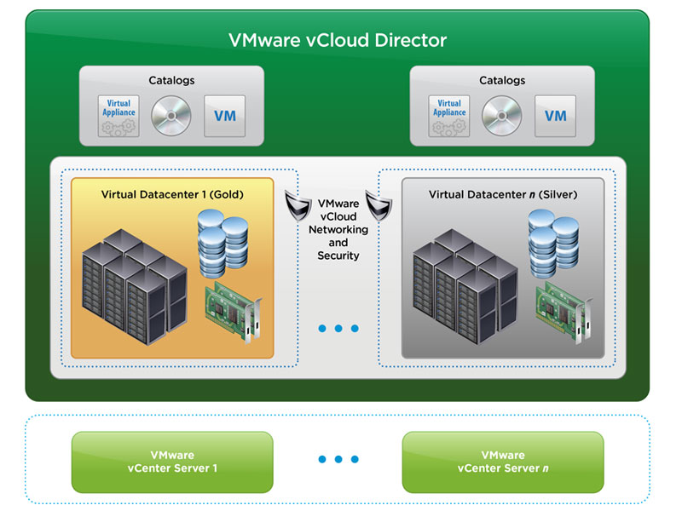
Challenge:
Protect vCloud Director environments
  What is vCloud Director (vCD)?
  Adds a level of abstraction above vSphere to create an Infrastructure-as-a-service environment
  Enables fast, automated provisioning of virtualized applications and services

Slide 25
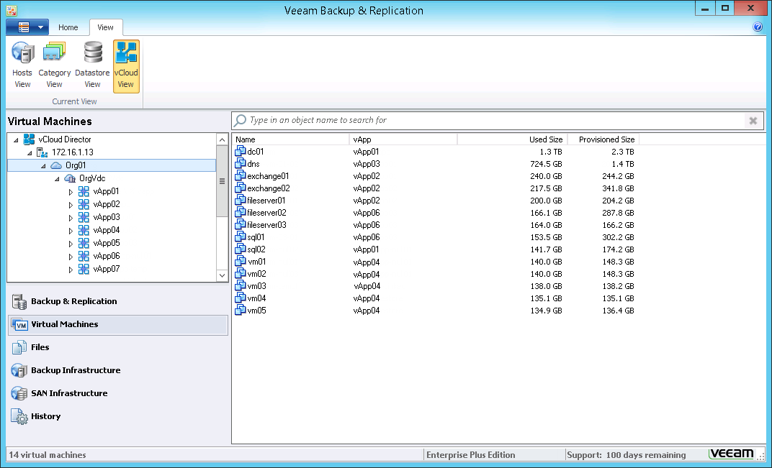
Solution:
Enhanced backup and recovery for vCloud Director
Backup all vApp and VM metadata and attributes
Restore vApps, VMs and fast-provisioned VMs directly to vCloud Director
Integrated views of vCloud Director infrastructure in backup, monitoring and reporting consoles

Slide 26
Important details
Requires vCloud Director 5.1 or higher

Slide 27
Challenge:
Simplify backup monitoring
  Monitor backups directly from vSphere
  At-a-glance views of backup job, proxies and repositories
  Easily identify unprotected VMs

Slide 28
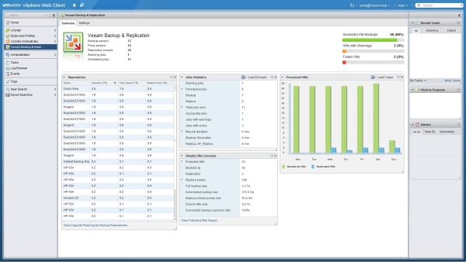
Solution:
vSphere Web Client plug-in
Summary of backup job status
Overview of backup infrastructure
Backup repository statistics
Daily backup activity

Slide 29
Advanced reporting and capacity planning
Capacity planning for backup repositories
Protected VMs report
Requires Veeam Backup Management Suite

Slide 30
Recover exactly what you need – in minutes, not hours

Slide 31
Challenge:
Fast, easy recovery
Solutions:
Enhanced 1-Click Restore
Self-service recovery
Veeam Explorer for Microsoft SharePoint
Veeam Explorer for Microsoft Exchange 2013

Slide 32
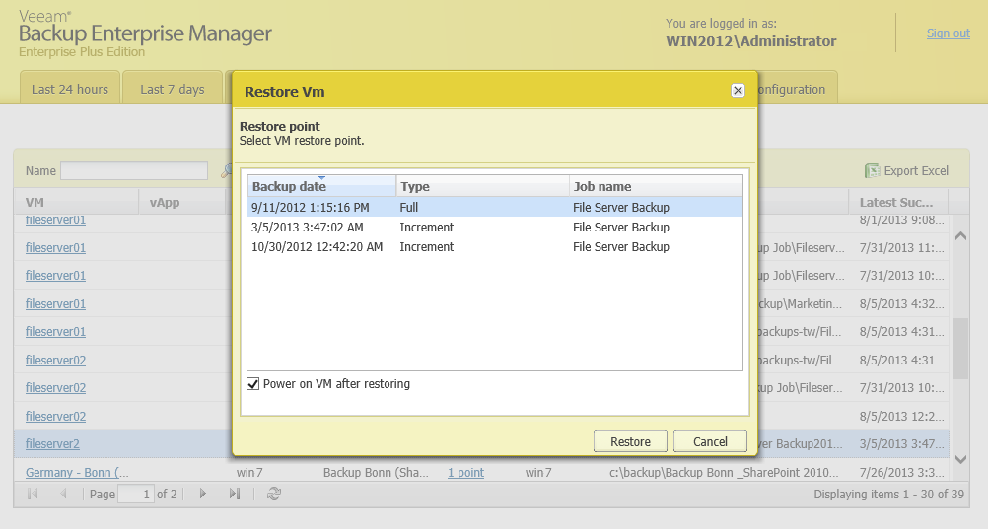
Enhanced 1-Click Restore
  In addition to files, can now also recover VMs

Slide 33
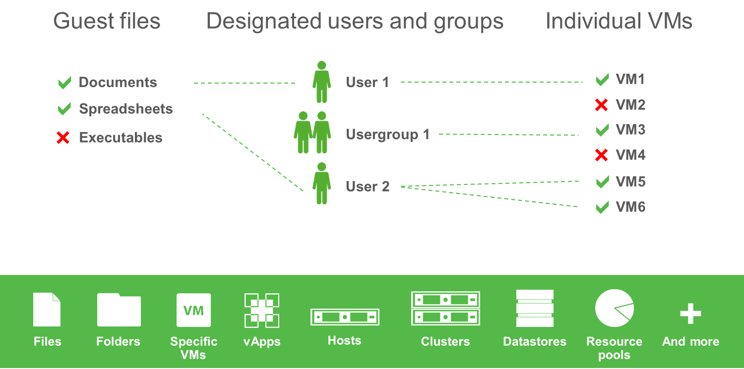
Self-service recovery
  Safely delegate recovery of guest files and VMs
  Faster restores
  Decreased burden on IT staff
  Audit operator restore activity*
* Requires Veeam Backup Management Suite

Slide 34
Veeam Explorer for Microsoft SharePoint
Veeam Explorer for Microsoft Exchange 2013
Fast, agentless restore of SharePoint and Exchange items
Easy e-discovery and browsing
Advanced search for items and objects
Quick recovery via save, send, export, and restore to original location
No agents
No special backups
No additional license fees

Slide 35
Important details
Veeam Explorer for Microsoft SharePoint supports Microsoft SharePoint 2010

Slide 36
Product Suites

Slide 37
Modern Data Protection
Product suites
All the features and benefits of Veeam Backup & Replication,
plus…
Veeam Backup Essentials
Savings of 33% or more for small businesses with:
  virtual environments with 2, 4 or 6 sockets
  typically fewer than 200 employees
Veeam Backup Management Suite
Advanced monitoring, reporting and capacity planning for backup and virtual infrastructures of all sizes

Slide 38
v7 highlights
Infrastructure Assessment tools
  VM Change Rate Estimation report for planning backup repository requirements
  VM Configuration Assessment report for determining VM backup readiness (VMware only)
Enhanced reporting
  14 new backup reports, a backup dashboard and widgets
  2 new VMware reports for monitoring cluster performance
  Report content and usability improvements
Integrated support for vCloud Director (vCD)
  Summary views of health and status
  Prebuilt alerts and 24x7 monitoring of all vCD objects
  Performance and configuration reports and widgets

Slide 39
Editions

Slide 40
Introducing Enterprise Plus
Flexibility and choice: three editions so you can choose the one that best meets your needs and budget
Product | Standard | Enterprise | Enterprise Plus
Veeam Backup & Replication |  |  | 
Veeam Backup Management Suite |  |  | 
Veeam Backup Essentials |  |  | 

Slide 41
Edition comparison of v7 features
v7 Features | Standard | Enterprise | Enterprise Plus
Built-in WAN Acceleration |  |  | 
Backup Copy jobs |  |  | 
Native tape support ¹ |  |  | 
Backup from Storage Snapshots (VMware only) |  |  | 
Virtual Lab for replicas (VMware only) |  |  | 
Enhanced support for vCloud Director ² |  |  | 
vSphere Web Client plug-in |  |  | 
Virtual Lab for Hyper-V (backups only) |  |  | 
Full Instant File-Level Recovery for Hyper-V (Windows, Linux, et al) |  |  | 
1-Click Restore for VMs |  |  | 
Self-Service Recovery of VMs and guest files |  |  | 
Veeam Explorer for Microsoft SharePoint ³ |  |  | 
Veeam Explorer for Microsoft Exchange 2013 ³ |  |  | 
Task automation ⁴ |  |  | 
All editions support copying Windows files to tape. Enterprise and Enterprise Plus editions also support copying Veeam backups to tape with full tracking of backups and restore points.
All editions provided integrated visibility of vCloud Director (vCD) infrastructure, backup via VeeamZIP (including backup of vApp and VM meta data and attributes) and direct restore to vCD. Enterprise and Enterprise Plus editions also support scheduled incremental backup jobs of vCD VMs.
All editions support restore via save, send and export. Enterprise and Enterprise Plus editions also support restore to original location.
Standard and Enterprise editions support PowerShell. Enterprise Plus edition also supports RESTful API.

Slide 42
Screenshots

Slide 43
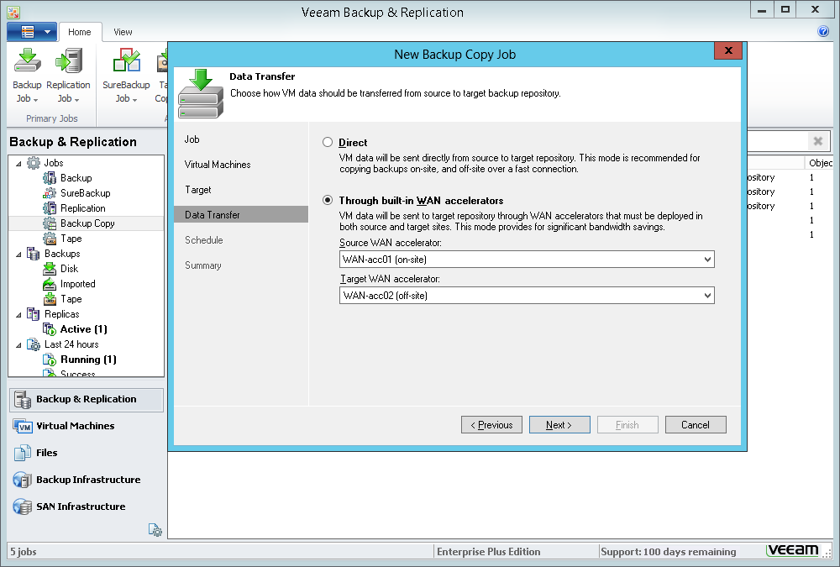
Notes:
Built-in WAN Acceleration helps you copy backups to offsite locations up to 50 times faster.

Slide 44
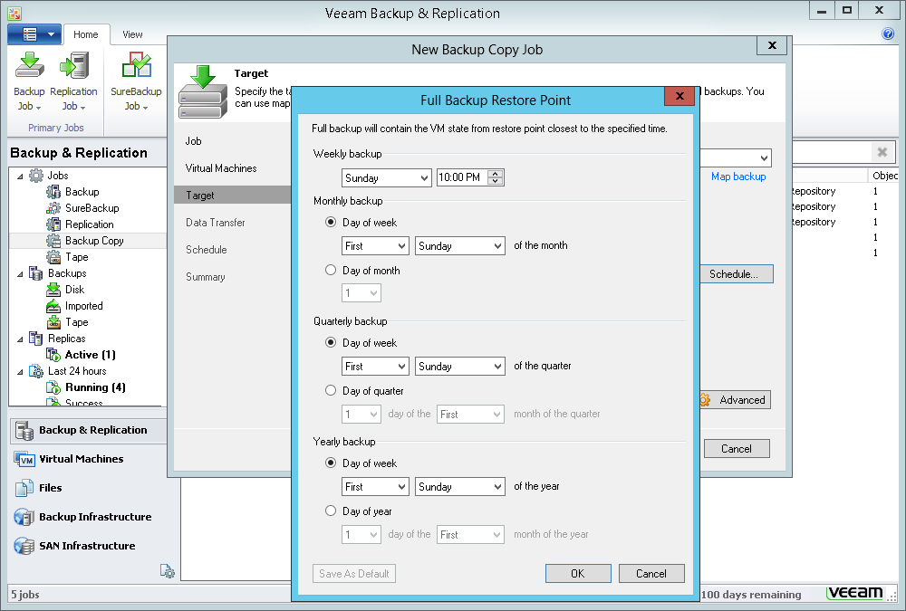
Notes:
Backup copy jobs enable Grandfather-Father-Son (GFS) retention strategy.

Slide 45
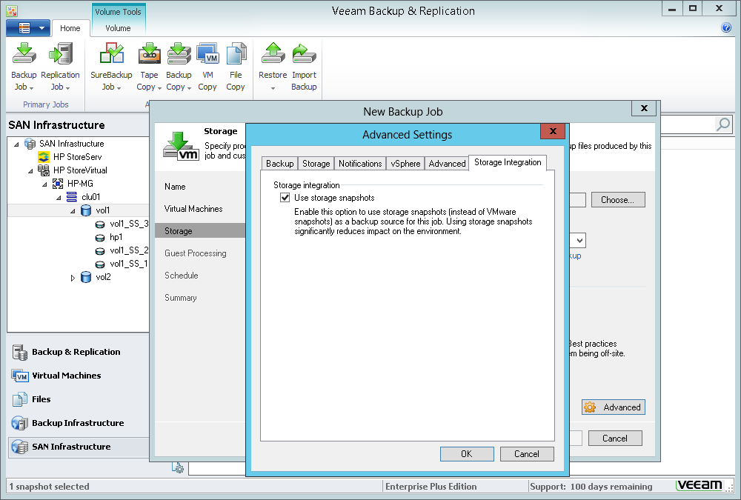
Notes:
Backup from Storage Snapshots dramatically improves RPOs without affecting your production environment or running VMs.

Slide 46
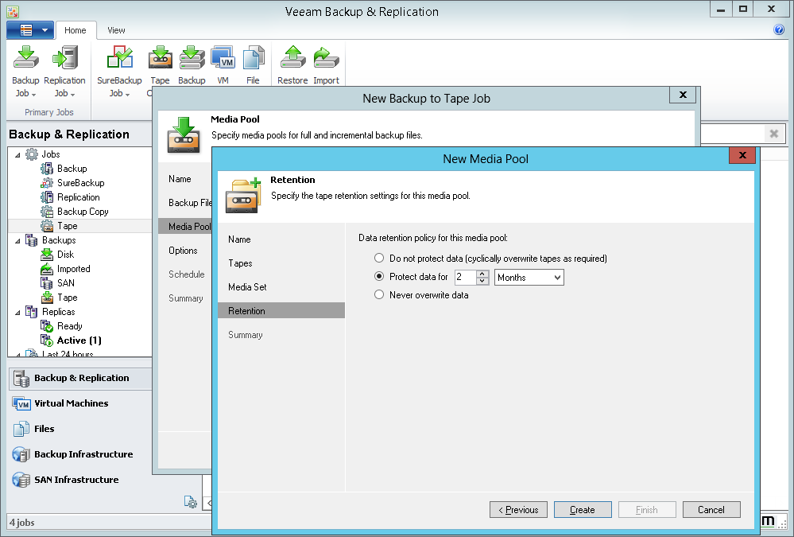
Notes:
Native tape support lets you take advantage of the policies you’ve built around tape.

Slide 47
Notes:
Specifying tape as a secondary target destination for your backup jobs automates workflow and helps implement ‘3-2-1’ rule for data protection.

Slide 48
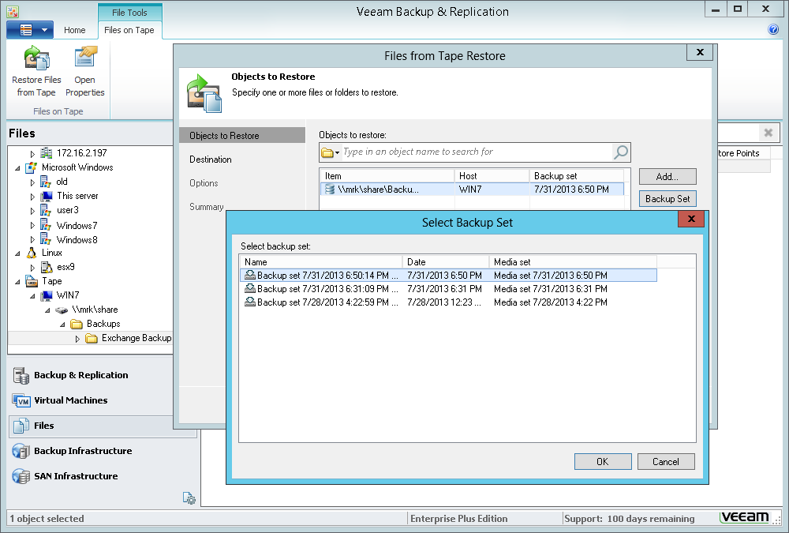
Notes:
Full tracking of restore points simplifies restores from backups on tape.

Slide 49
Notes:
Enhanced support for vCloud Director protects your vApps and VMs.

Slide 50
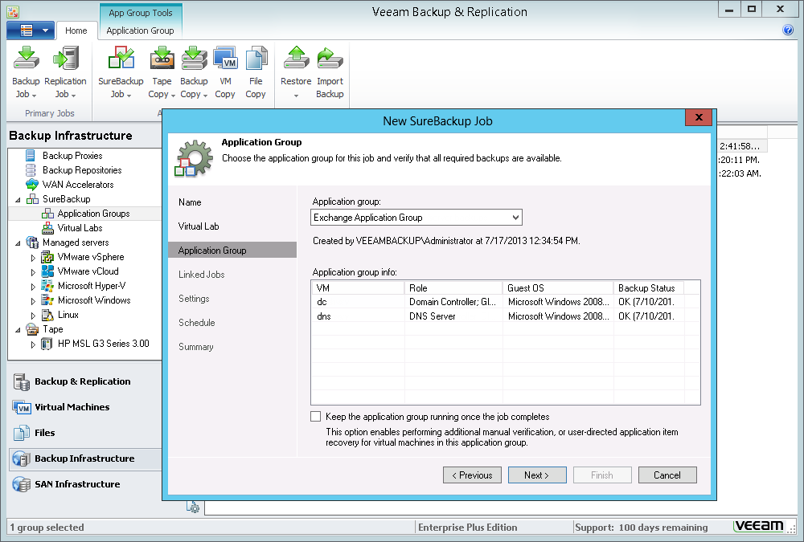
Notes:
Virtual Lab for Microsoft Hyper-V brings SureBackup, U-AIR and On-Demand Sandbox to Hyper-V.

Slide 51
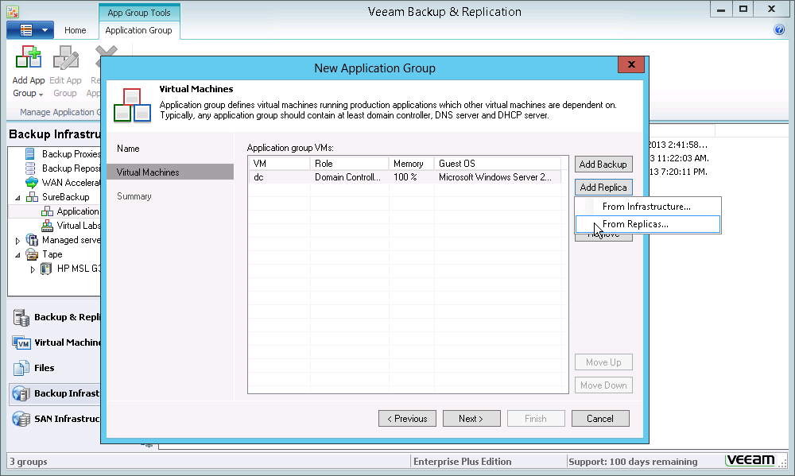
Notes:
SureReplica automatically verifies every restore point of every replica.

Slide 52
Notes:
1-Click Restore in Enterprise Manager now lets you quickly and easily recover individual VMs.

Slide 53
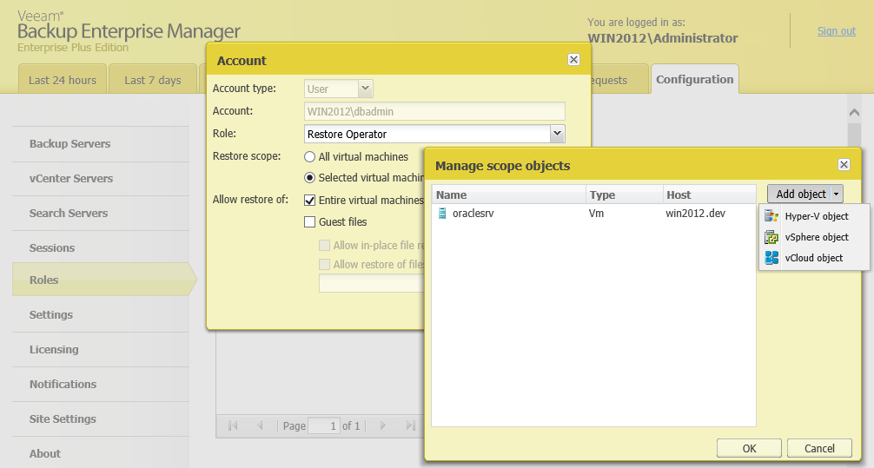
Notes:
Flexible delegation settings enable self-service recovery of VMs and files.

Slide 54
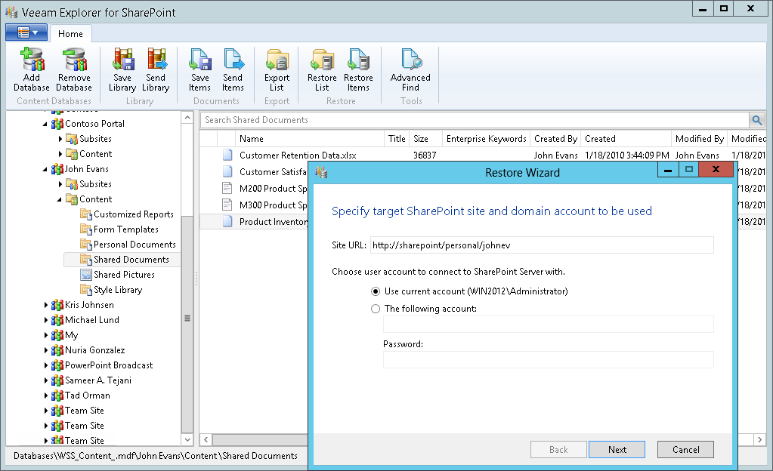
Notes:
Veeam Explorer for Microsoft SharePoint provides built-in e-discovery and quick restore of individual SharePoint items.

Slide 55
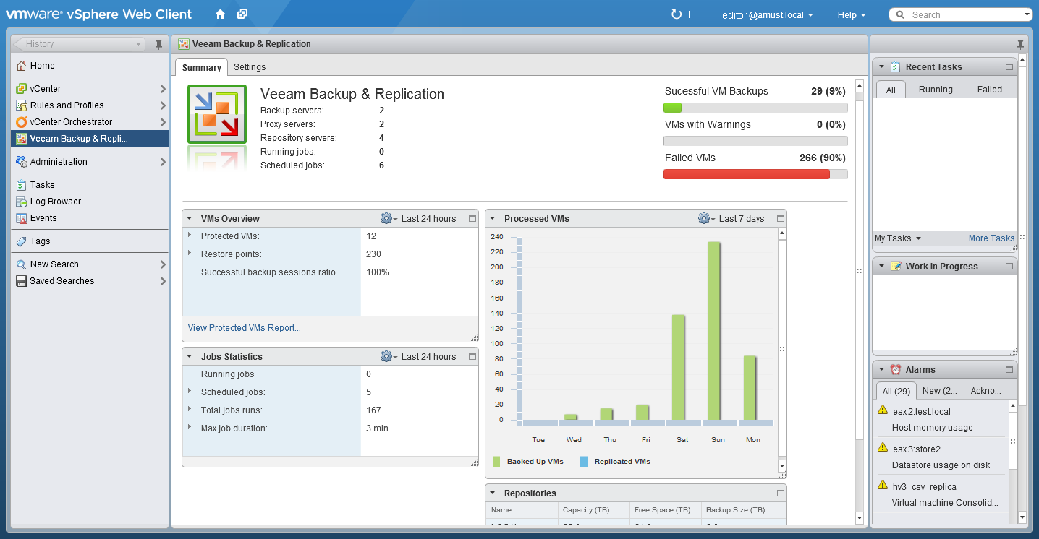
Notes:
Monitor your backup infrastructure directly from the vSphere Web Client.

Slide 56
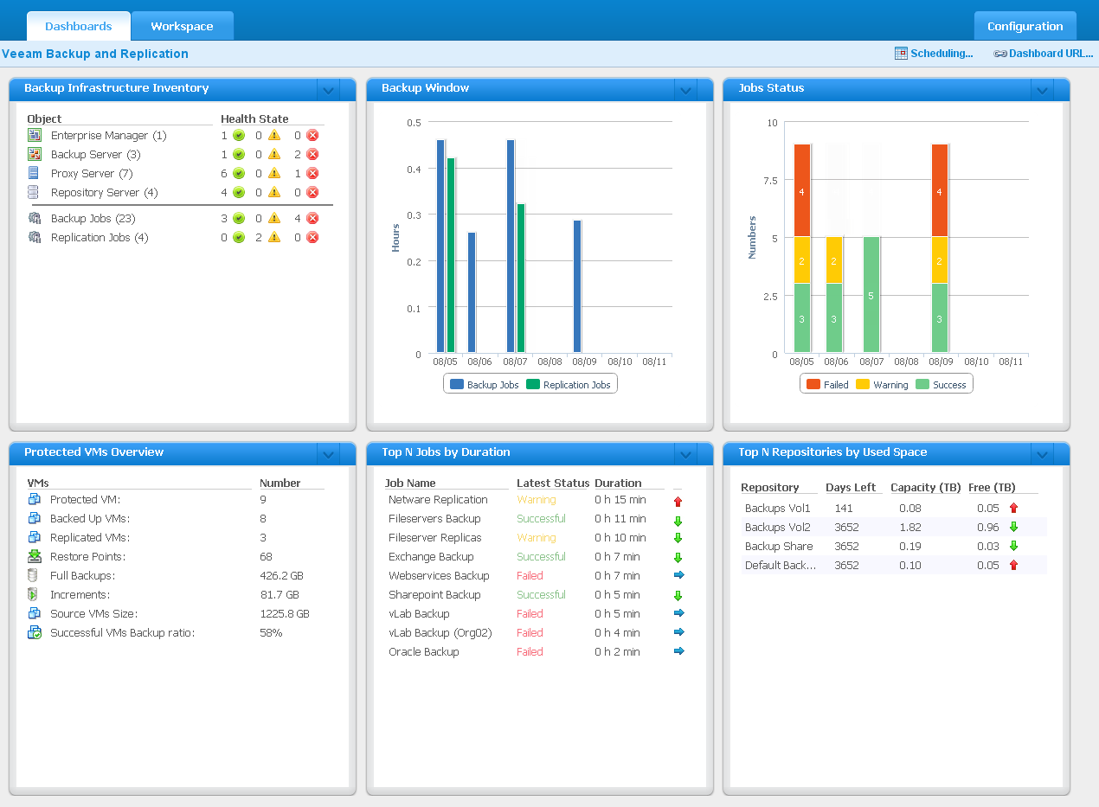
Notes:
Get an at-a-glance view of your backup infrastructure and jobs.

Slide 57
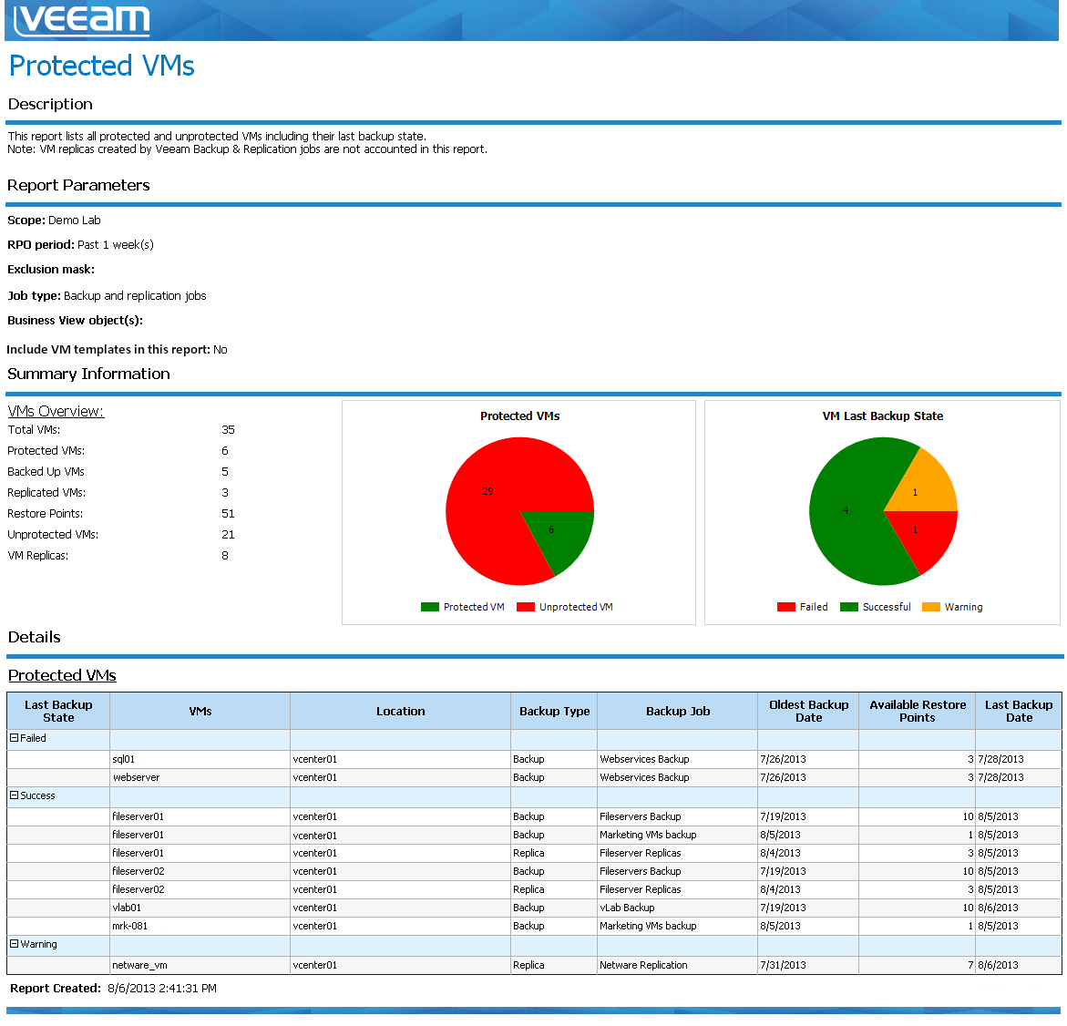
Notes:
Ensure all mission-critical VMs are protected with valid backups and replicas.

Slide 58
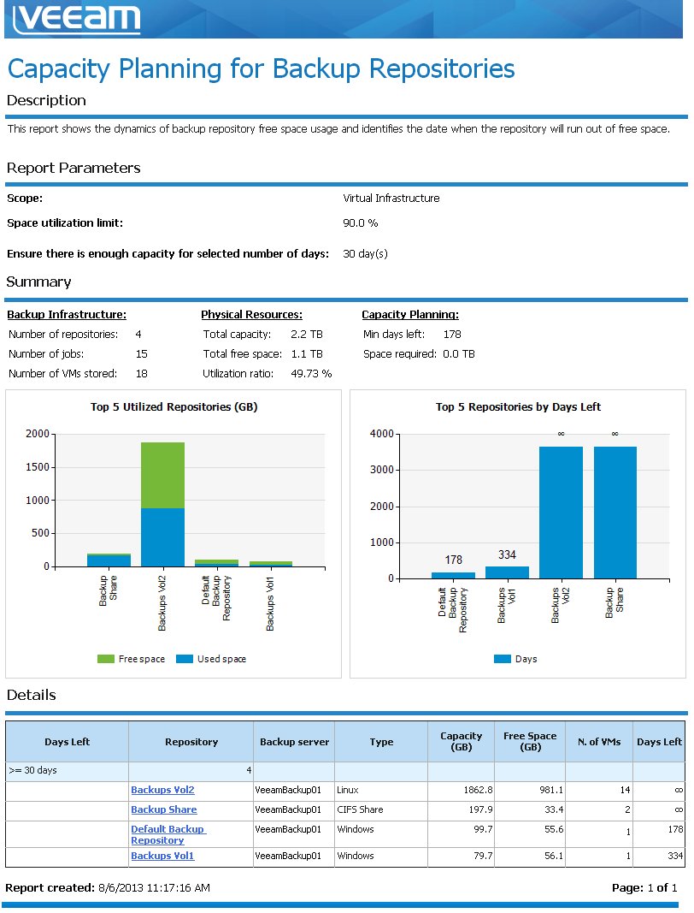
Notes:
Verify your backup repositories have enough capacity.

Slide 59
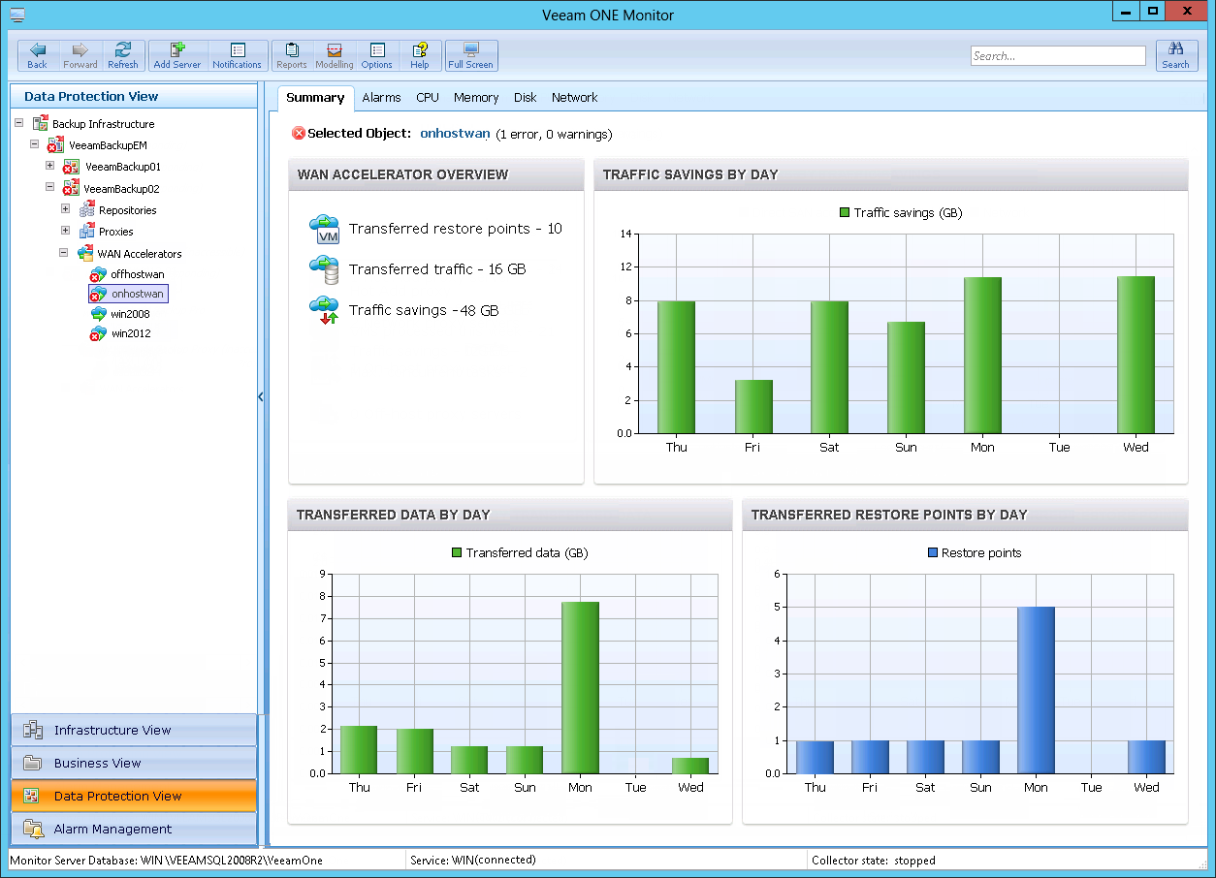
Notes:
Track the real-time traffic savings from Built-in WAN Acceleration.

Slide 60
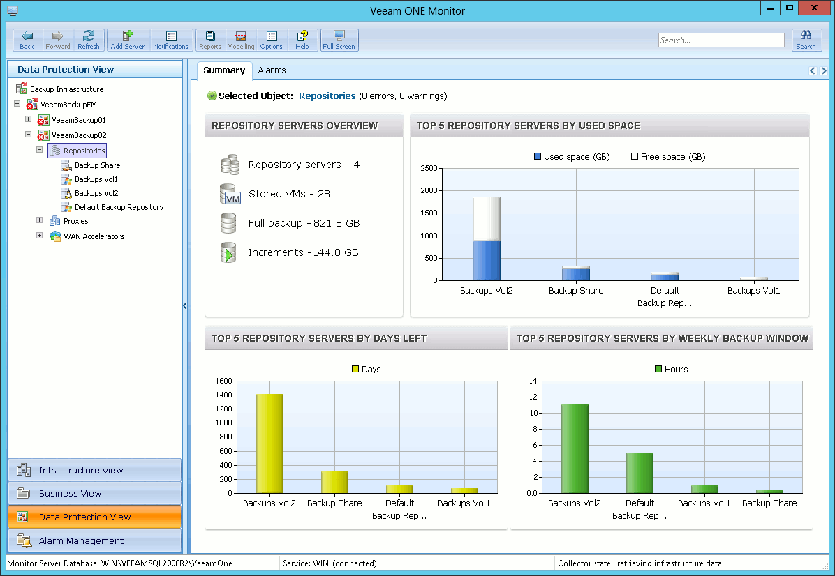
Notes:
Get a summary view of your complete backup infrastructure.

Slide 61
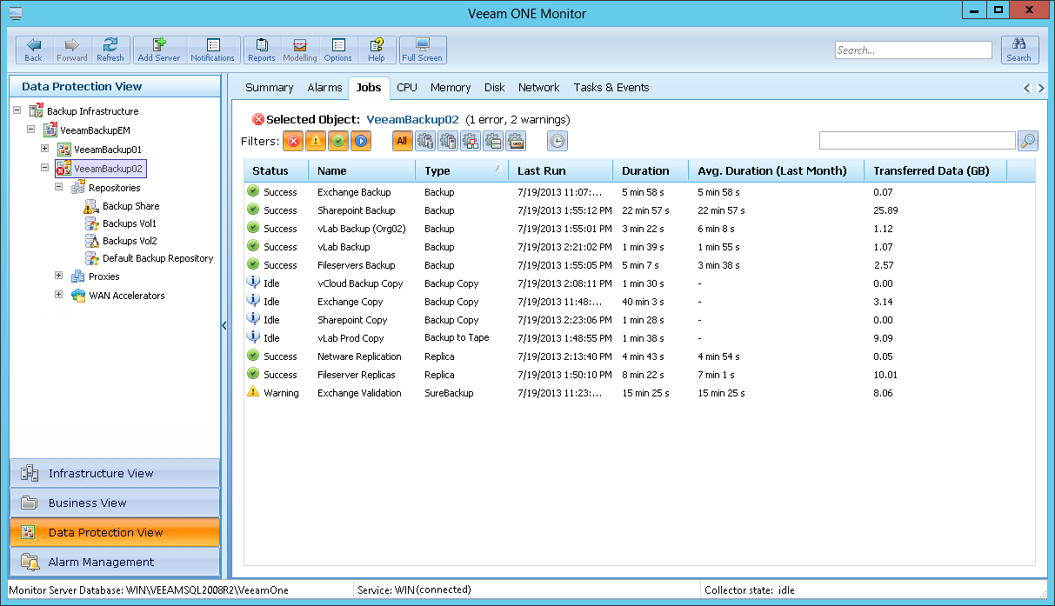
Notes:
Track the status of all jobs across all Veeam Backup & Replication servers.

Slide 62
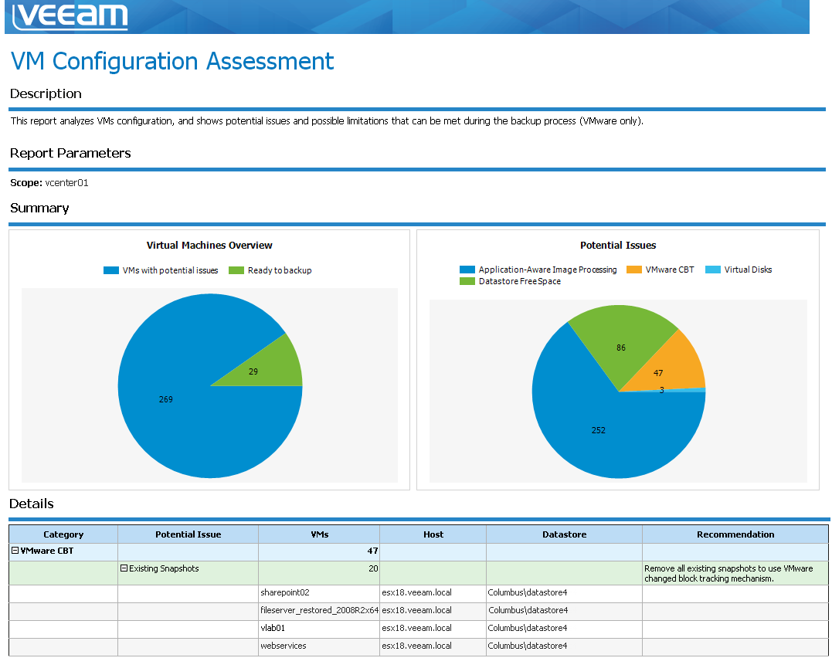
Notes:
Analyze VMware VM configuration settings to identify issues that might prevent successful backups.

Slide 63
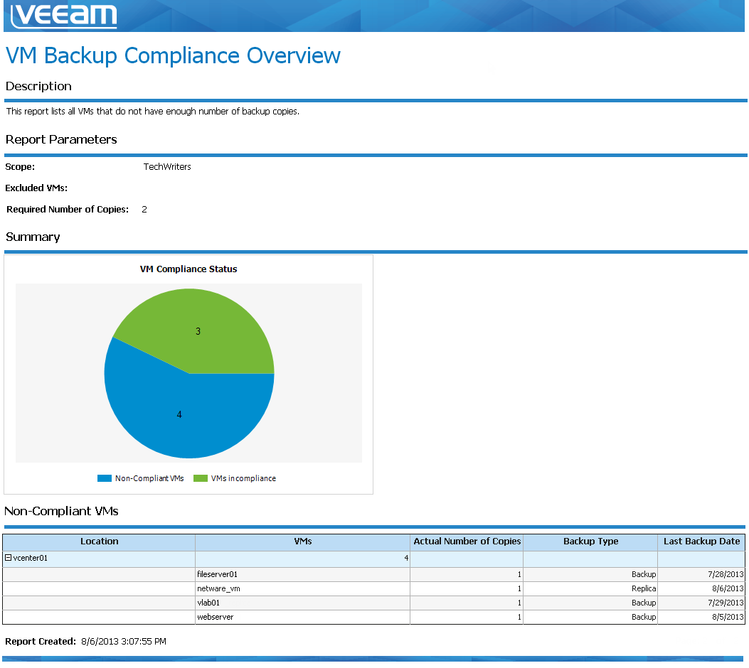
Notes:
Identify VMs that are not protected by the recommended number of backup copies.

Slide 64
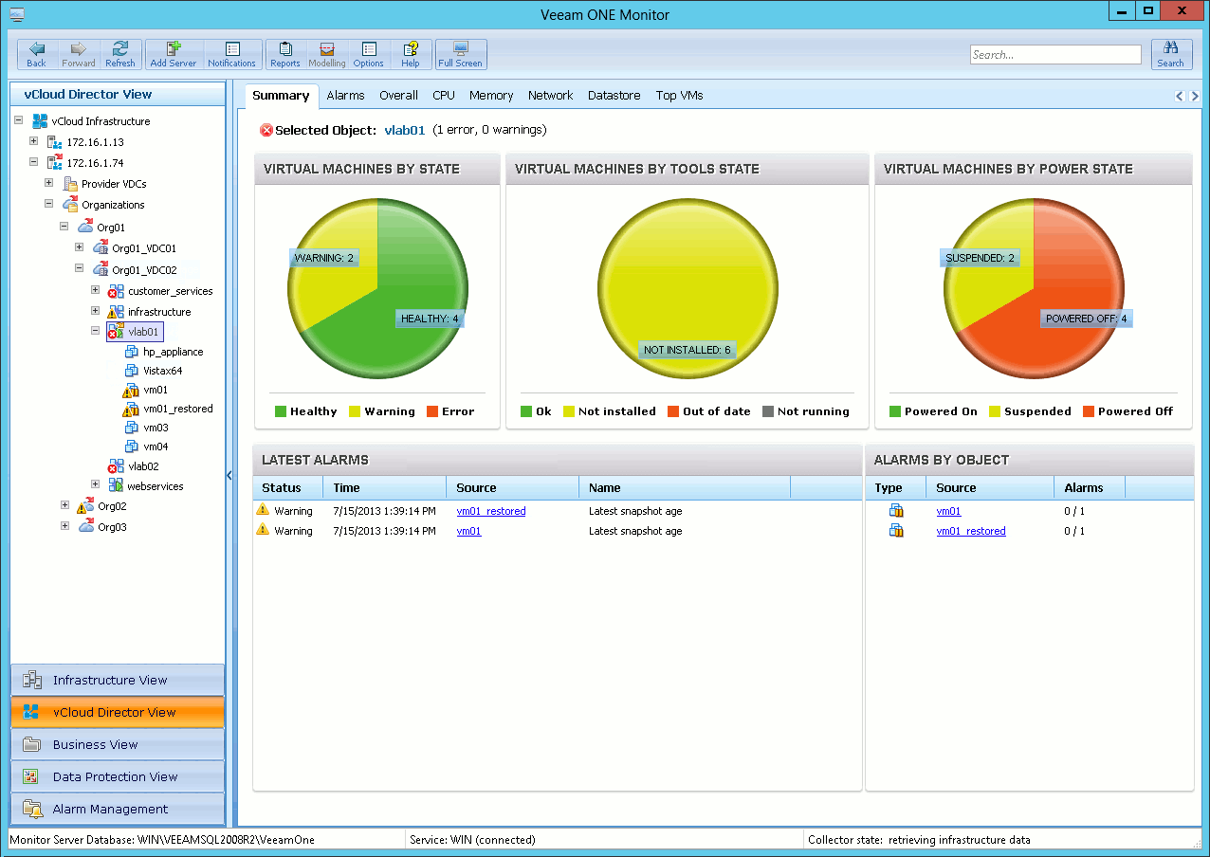
Notes:
Monitor all aspects of your vCloud Director infrastructure and supporting vSphere components.

Slide 65
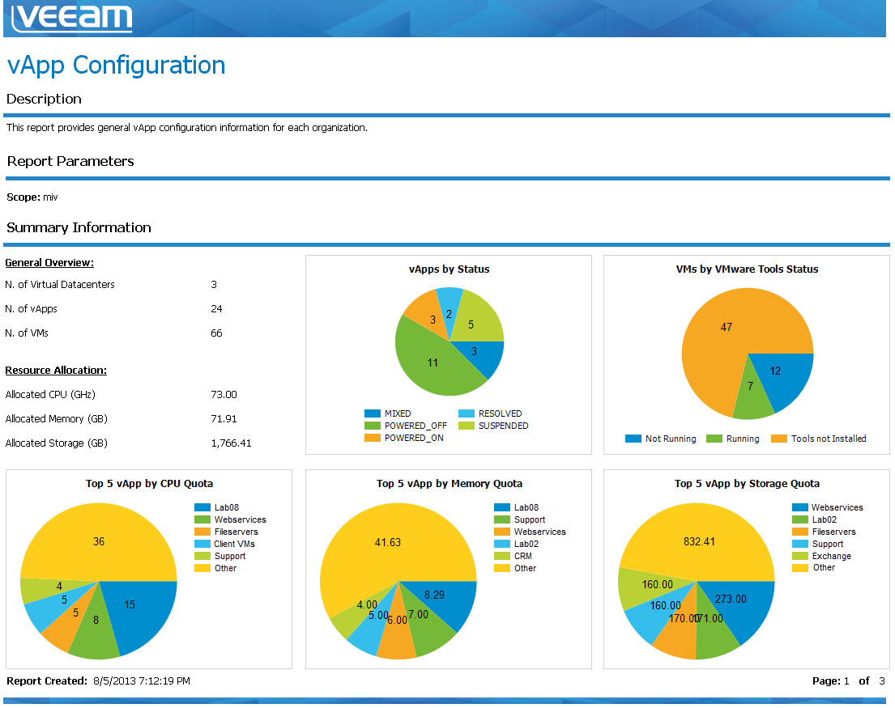
Notes:
Review the configuration of the vApps in your vCloud Director environment.

